Slide 1
have/has +
past participle

Slide 2
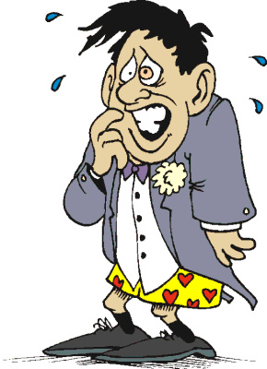
feel
ride
tell
lose
have
break
work
spend
sell
forget
forgot
forgotten
leave
forget
Choose the correct verb.
see
speak
get
fall
drink
be
eat
win
meet
I think I ________________ my trousers.
have forgotten

Slide 3
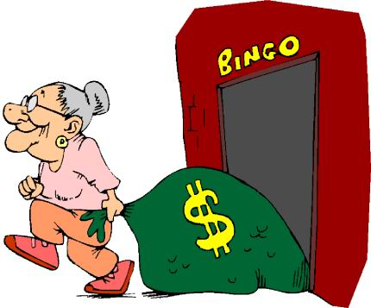
feel
ride
tell
lose
have
break
work
spend
sell
leave
forget
Choose the correct verb.
see
speak
get
fall
drink
be
eat
win
won
won
win
meet
It’s the second time this week that granny________ a game of bingo.
has won

Slide 4
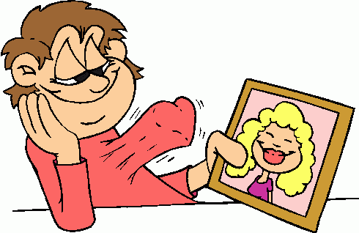
feel
ride
tell
lose
have
break
work
spend
sell
leave
forget
Choose the correct verb.
see
speak
get
fall
fell
fallen
fall
drink
be
eat
win
meet
has fallen
He __________ in love with
the new girl in his class.

Slide 5
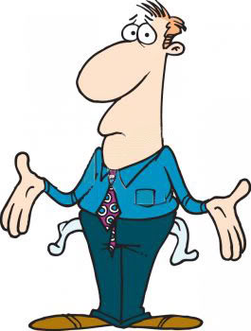
feel
ride
tell
lose
have
break
work
spend
spent
spent
spend
sell
leave
forget
Choose the correct verb.
see
speak
get
fall
drink
be
eat
win
meet
I___________ all my money.
have spent

Slide 6
feel
ride
tell
lose
have
break
work
worked
worked
work
spend
sell
leave
forget
Choose the correct verb.
see
speak
get
fall
drink
be
eat
win
meet
My father____________ hard all day.
has worked

Slide 7
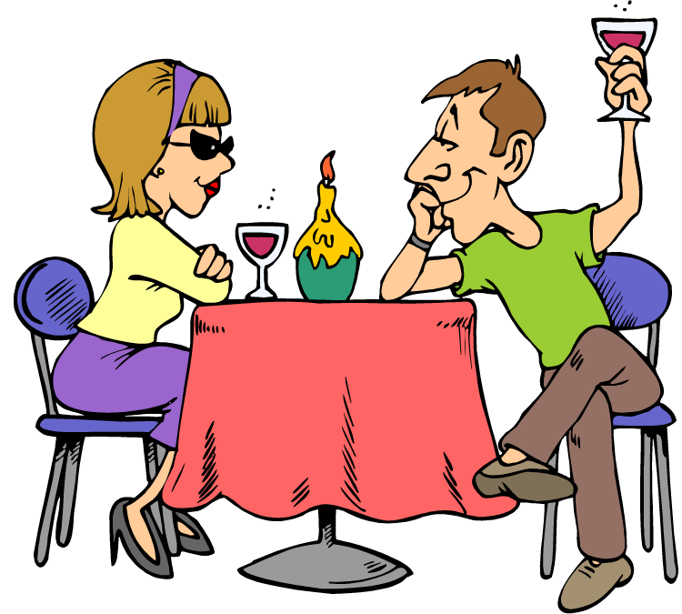
feel
ride
tell
lose
have
had
had
have
break
work
spend
sell
leave
forget
Choose the correct verb.
see
speak
get
fall
drink
be
eat
win
meet
have had
We _________ dinner together
a few times this week.

Slide 8
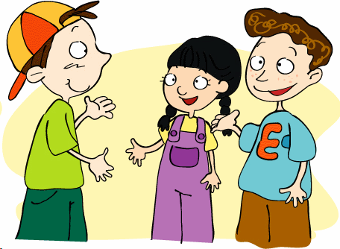
feel
ride
tell
lose
have
break
work
spend
sell
leave
forget
Choose the correct verb.
see
speak
get
fall
drink
be
eat
win
meet
met
met
meet
have met
I _____ finally _____ Lucy, the new student from the USA.

Slide 9
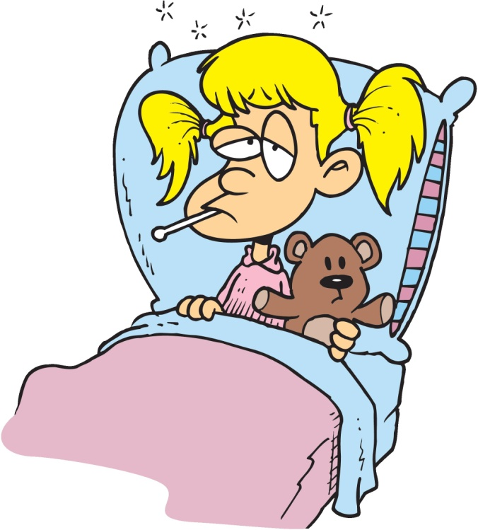
feel
felt
felt
feel
ride
tell
lose
have
break
work
spend
sell
leave
forget
Choose the correct verb.
see
speak
get
fall
drink
be
eat
win
meet
She________ very sick since Friday.
has felt

Slide 10
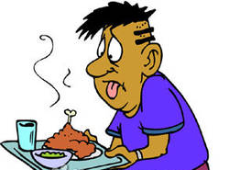
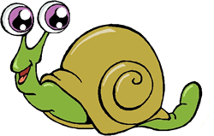
feel
ride
tell
lose
have
break
work
spend
sell
leave
forget
Choose the correct verb.
see
speak
get
fall
drink
be
eat
ate
eaten
eat
win
meet
Seth_____never ______ snails before.
has eaten

Slide 11
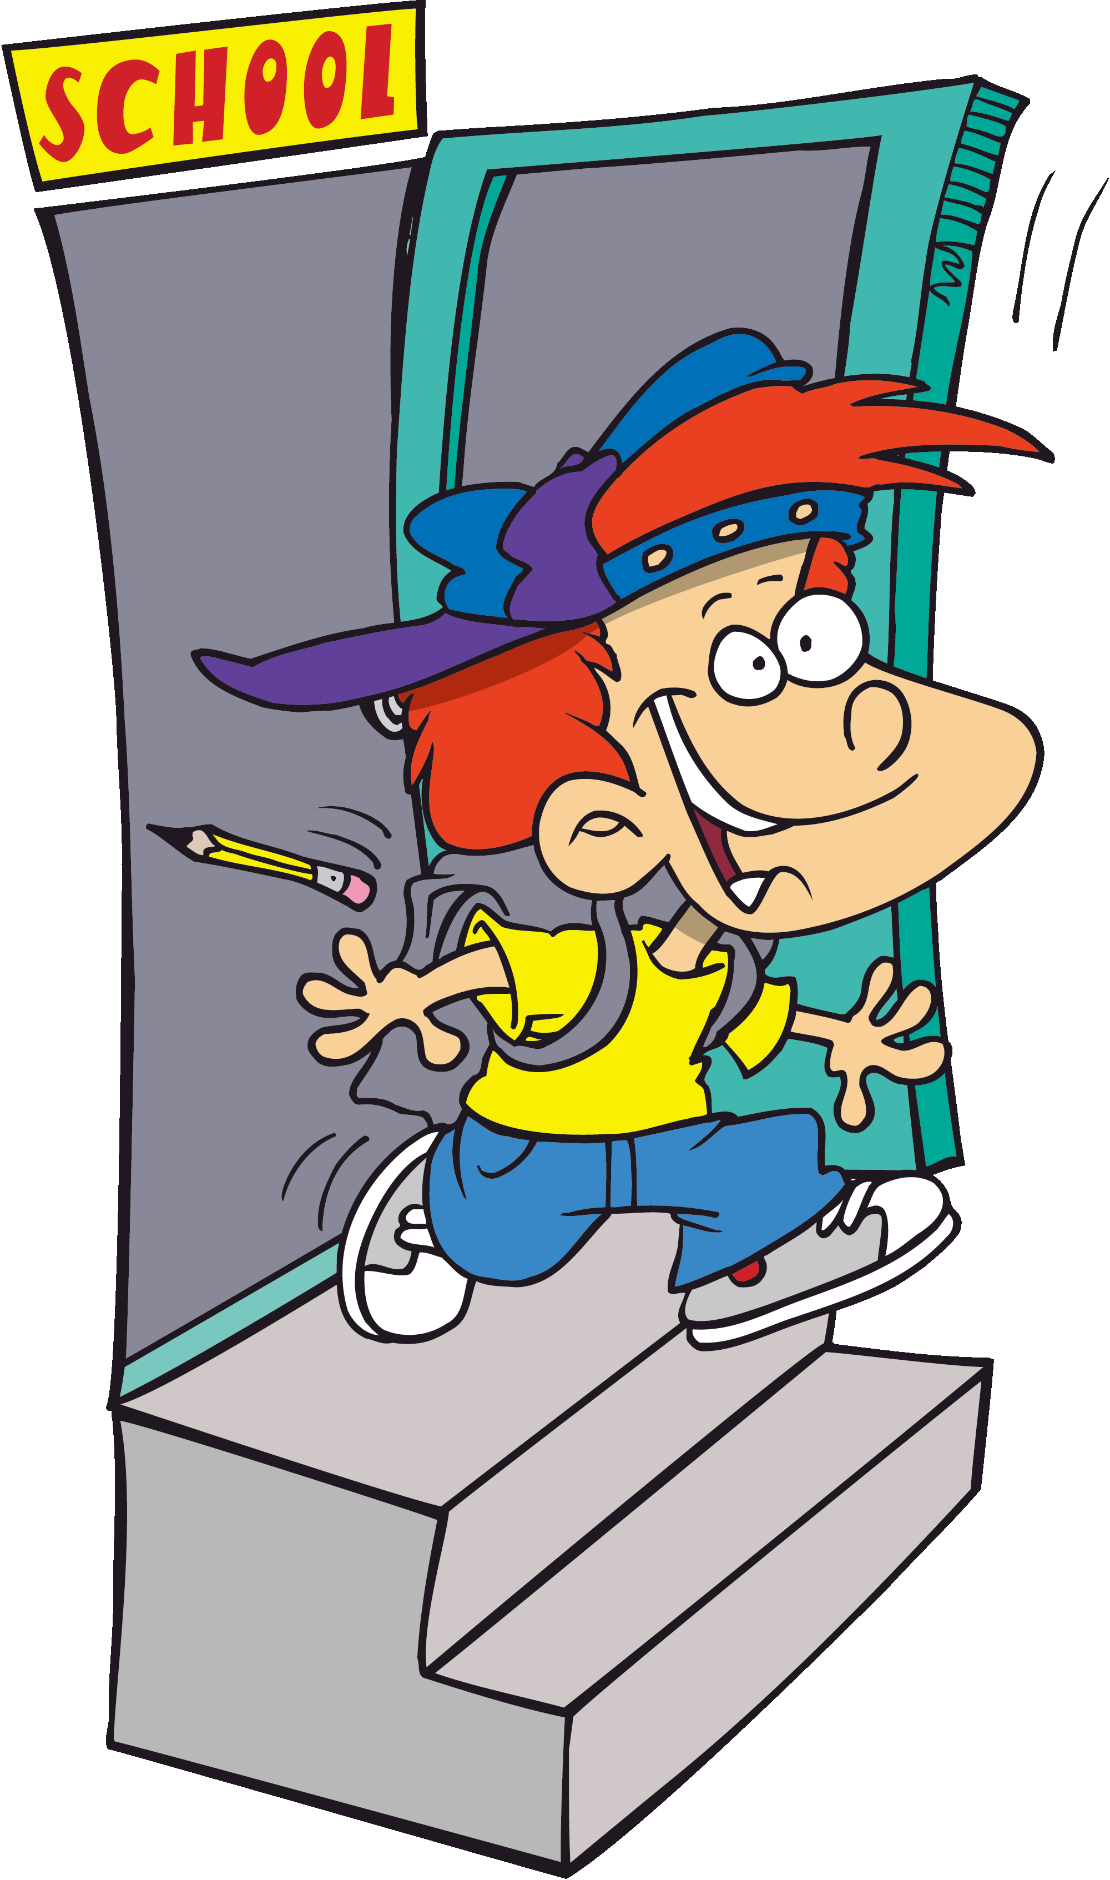
feel
ride
tell
lose
have
break
work
spend
sell
leave
left
left
leave
forget
Choose the correct verb.
see
speak
get
fall
drink
be
eat
win
meet
Rob ____ just ____ school.
has left

Slide 12
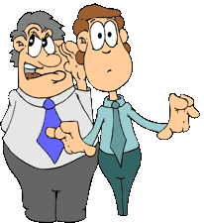
tell
told
told
feel
ride
tell
lose
have
break
work
spend
sell
leave
forget
Choose the correct verb.
see
speak
get
fall
drink
be
eat
win
meet
He________ me Jane’s secret.
has told

